Slide 1
Implementing the NIH Data Management and Sharing (DMS) Policy
June 2023

Slide 2
Policy Applicability

Slide 3

NIH has a longstanding commitment to making the results of research available.
Data Management and Sharing Policy will create a consistent minimum expectation for all research supported by agency.

Slide 4
Policy Effective Dates
The DMS Policy applies to all NIH funding mechanisms
Extramural | Competing applications submitted for Jan 25, 2023, and subsequent receipt dates
Contracts | Proposals submitted on or after Jan 25, 2023
Intramural | Projects conducted on or after Jan 25, 2023
Other funding agreements (e.g., Other Transactions) | Executed on or after Jan 25, 2023, unless otherwise stipulated by NIH

Slide 5
Scope of DMS Policy
Applies to all research, funded or conducted in whole or in part by NIH, that results in the generation of "scientific data“.
"Scientific data" is defined as:
  "the recorded factual material commonly accepted in the scientific community as of sufficient quality to validate and replicate research findings, regardless of whether the data are used to support scholarly publications."

Slide 6
Potential Examples of Scientific Data
Scientific data will vary depending on the
project and the context.
Scientific data might include:
Single-cell RNA sequencing (scRNA-seq) of T lymphocytes or other immune cells in a study of HIV/AIDS
Electrophysiological recordings and fMRI images in a study of a rodent model of PTSD
Step activity from a wearable device in a study of cardiovascular health

Slide 7
Exclusions from the DMS Policy
Scientific data do
not include:
  Data not necessary for or of sufficient quality to validate and replicate research findings,
  Laboratory notebooks,
  Preliminary analyses,
  Completed case report forms,
  Drafts of scientific papers,
  Plans for future research,
  Peer reviews,
  Communications with colleagues, or
  Physical objects, (e.g., laboratory specimens)

Slide 8
Activities Subject to the DMS Policy
APPLIES TO…
All research generating scientific data, including but not limited to:
Research Projects
Certain Career Development Awards (Ks)
Small Business SBIR/STTR
Research Centers
DOES NOT APPLY TO…
Research projects not generating scientific data or non-research projects, including but not limited to:
Training (Ts)
Fellowships (Fs)
Construction (C06)
Conference Grants (R13)
Resources (Gs)
See Research Covered Under the Data Management & Sharing Policy

Slide 9
Policy Requirements
Submission of Data Management & Sharing Plan with all applications for funding beginning January 25, 2023
Compliance with the Data Management and Sharing Plan approved by the funding NIH Institute, Center, or Office

Slide 10
Planning & Budgeting

Slide 11
Elements of a DMS Plan
Data type
  Identifying data to be preserved and shared
Related tools, software, code
  Tools and software needed to access and manipulate data
Standards
  Standards to be applied to scientific data and metadata
Data preservation, access, timelines
  Repository to be used, persistent unique identifier, and when/ how long data will be available
Access, distribution, reuse considerations
  Description of factors for data access, distribution, or reuse
Oversight of data management and sharing
  Plan compliance will be monitored/ managed and by whom
Plan Elements
Data Type
Related tools, Software and/or Code
Standards
Data Preservation, Access and Associated Timelines
Access, Distribution, or Reuse Considerations
Oversight of Data Management and Sharing
See Writing a Data Management & Sharing Plan for details

Slide 12
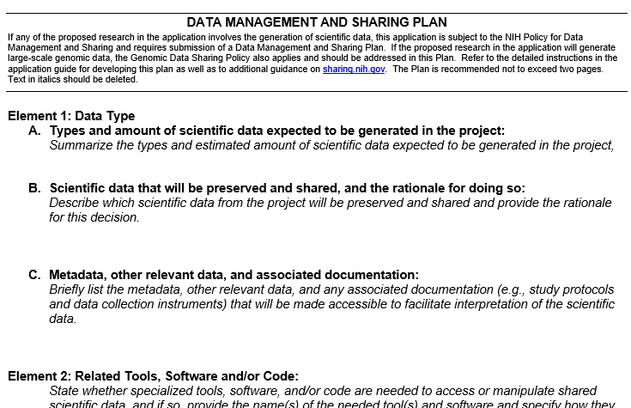
Format of a DMS Plan
Plan recommended not to exceed 2 pages in length
Optional format page will be available
DMS Plan Format Page

Slide 13
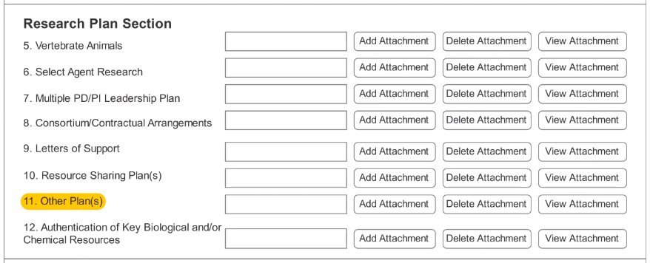
DMS Plan Submission
A new “Other Plan(s)” field added to the PHS 398 form to collect a single PDF attachment
Data Sharing Plans and Genomic Data Sharing Plans will no longer be submitted to the “Resource Sharing Plan(s)” field

Slide 14

DMS Plan Assessment
NIH Program staff:
  Ensure Elements of a DMS Plan have been adequately addressed and assess the reasonableness of those responses
  Applications will only be funded when Plan is complete and acceptable
Peer reviewers:
  Consider if budget is reasonable
See Writing a Data Management & Sharing Plan

Slide 15
Resolving Plan Issues Before Award
DMS Plan must be approved prior to award
If additional details needed, communicate with NIH staff to resolve issues with DMS Plan
  Will occur through standard Just-In-Time (JIT) process
  Provide additional information and potentially a revised DMS Plan
See Writing a Data Management & Sharing Plan

Slide 16
Monitoring Compliance
Approved Plan becomes a Term and Condition of Award
Grantee reports progress of approved DMS Plan in RPPR*
NIH reviews compliance annually
Failure to comply may result in an enforcement action and affect future funding decisions.
*RPPR: Research Performance Progress Report (RPPR) - Annual, Interim, and Final

Slide 17
Data Management and Sharing Costs
ALLOWABLE COSTS:
Curating data/developing supporting documentation
Preserving/sharing data through repositories
Local data management considerations
IMPORTANT: Must be incurred during the performance period
UNALLOWABLE COSTS:
Infrastructure costs typically included in indirect costs
Costs associated with the routine conduct of research (e.g., costs of gaining access to research data)
See Budgeting for Data Management & Sharing for details

Slide 18
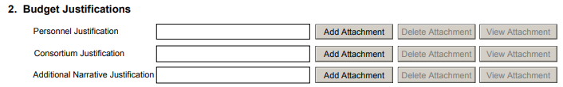
Submitting DMS Budgets
Include DMS costs in the appropriate cost category(ies), e.g., personnel, equipment, supplies, and other expenses, following standard budget form instructions.
Direct costs to support the activities proposed in the DMS Plan must be identified and explained in the appropriate budget justification attachment, along with a brief summary of the DMS Plan, in a section labeled “Data Management and Sharing Costs.”
  R&R Budget Form: Budget Justification attachment
  PHS 398 Modular Budget Form: Additional Narrative Justification attachment

Slide 19
Sharing Scientific Data

Slide 20
Finding and Selecting a Repository
Established repositories encouraged
NIH ICs may designate specific data repository(ies)
Recommend using a data-type or discipline-specific repository if available
Other suitable options include:
Institutional repositories
PubMed Central (small datasets only)
Generalist repositories
See Selecting a Data Repository for details

Slide 21
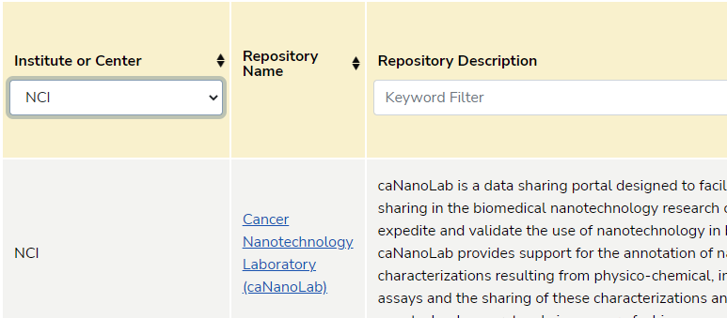
Finding and Selecting a Repository:
NIH & Other Resources
NIH-Supported Repositories
Other Repository Resources
Filterable list of 70+ NIH Repositories
Generalist repositories
Nature's Data Repository Guidance
Registry of Research Data Repositories
See Repositories for Sharing Scientific Data

Slide 22
When should I share my data?
As soon as possible!
No later than the time of a publication of findings in a peer-reviewed journal OR at the end of the award, whichever comes first
Sharing
Collection
Analysis/ Curation
Storage
Access/ Archive

Slide 23
Limitations on Sharing
DMS Plans should maximize appropriate sharing
  Justifiable ethical, legal, and technical factors for limiting sharing include:
    Informed consent will not permit or limits scope of sharing or use
    Privacy or safety of research participants would be compromised and available protections insufficient
    Explicit federal, state, local, or Tribal law, regulation, or policy prohibits disclosure
    Restrictions imposed by existing or anticipated agreements with other parties

Slide 24
Additional Policies & Expectations

Slide 25
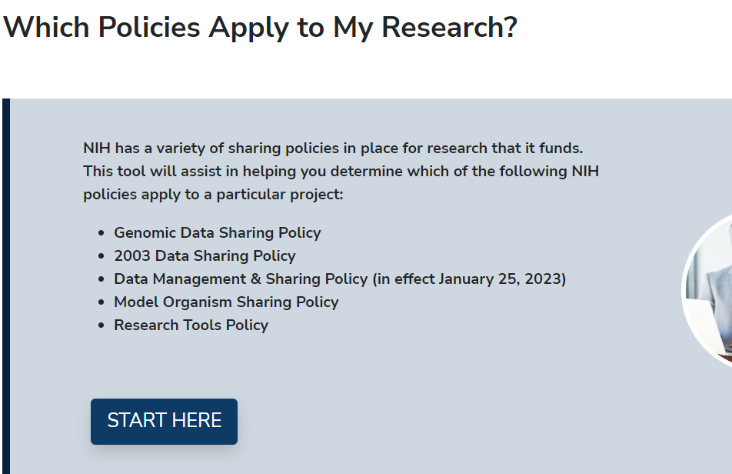
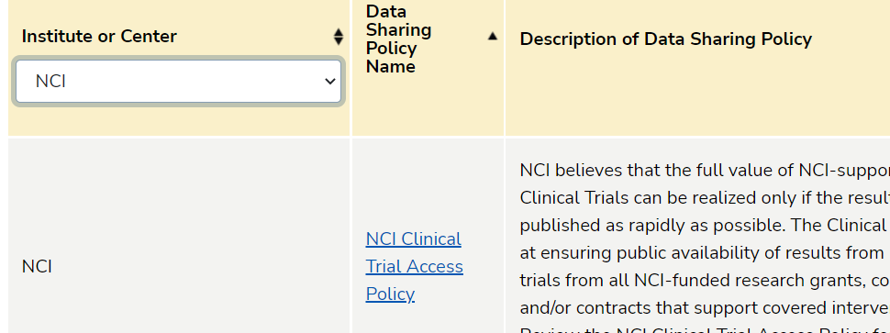
Is my research also subject to other NIH data sharing policies?
DECISION TOOL
NIH INSTITUTE AND CENTER DATA SHARING POLICIES

Slide 26
Harmonization: Research Subject to DMS and Genomic Data Sharing (GDS) Policies
DMS Plan: Include a single Plan that addresses GDS and DMS policies
DMS Plans Review: Plan Assessment conducted by program staff, not by peer reviewers
Budget Considerations: Detailed budget should include allow allowable costs for all data types
Compliance: Monitoring handled in accordance with DMS policy compliance and enforcement terms
Timing of Data Sharing: GDS policy provides specific timelines, the latest possible time to submit data will be at the end of the award performance period
NOT-OD-22-198

Slide 27
Protecting Privacy when Sharing Participant Data

Slide 28
Best Practices for Protecting Privacy When Sharing Human Research Participant Data
De-identify to the greatest extent while maintaining scientific utility; Use Common Rule and HIPAA Privacy Rule standards
Use agreements for transferring data
Communicate limitations on use, include prohibitions on re-identification or recontact
Consider risks from information even when de-identified
Share identifiable data only with explicit consent
Understand applicable legal protections and limitations on disclosure
1.
2.
3.
NOT-OD-22-213

Slide 29


Factors to Consider: Type of Access
  Sharing through controlled access if…
Explicit limitations on sharing
Data pose particular risks to participants or groups
Data cannot be sufficiently de-identified
Unanticipated risks are discovered after initial planning
    Sharing through unrestricted access if….
  Explicitly consented for unrestricted sharing
  De-identified and institutional review finds unrestricted sharing poses very low risk

Slide 30
Best Practices for Responsible Management and Sharing of AI/AN Participant Data
Understand
Understand Tribal sovereignty and laws, regulations, policies, and preferences
Engage
Engage early with Tribes when developing a data management and sharing plan, before research begins, and continue throughout research
Establish
Establish mutually beneficial partnerships
Agree
Agree who will manage data (e.g., Tribe, researcher, trusted 3rd party)
Consider
Consider additional protections, as necessary
NOT-OD-22-214

Slide 31
Resources

Slide 32
You Can Prepare Now
Familiarize yourself with the DMS Policy and resources available at sharing.nih.gov
Identify existing resources and expertise within your institution that may be able to assist you, such as data librarians
Try drafting a Data Management and Sharing Plan for your work based on the recommended elements (NOT-OD-21-014)
Review your past data sharing practices to meet other funder or publisher expectations and consider what you may need to update for the new Policy in the future

Slide 33

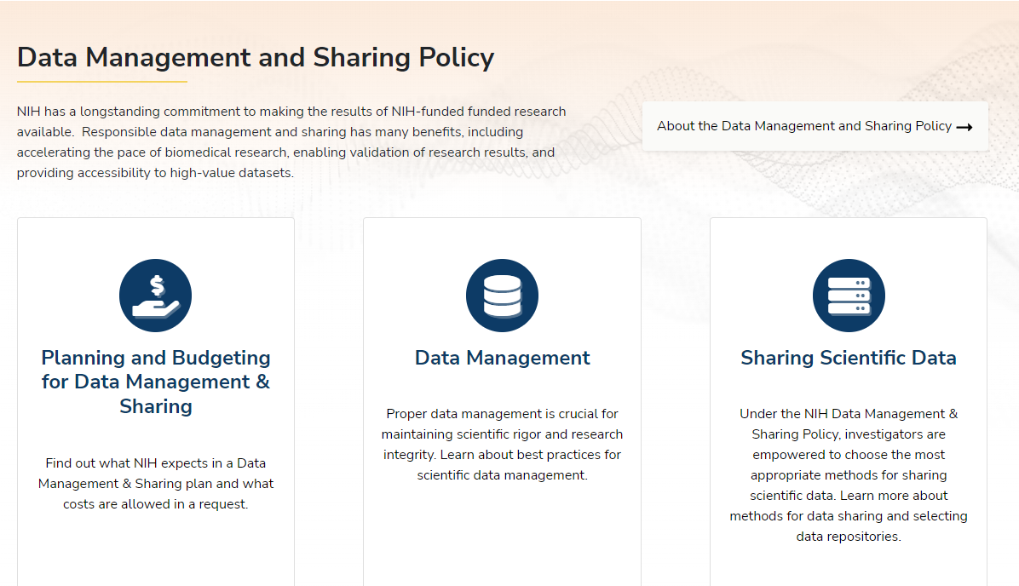
Scientific Data Sharing Website
Sharing Website

Slide 34

Frequently Asked Questions
FAQs

Slide 35

Featured Webinars
Implementing the New NIH Data Management and Sharing Policy: 2-part Series
NNLM Data Management and Sharing Series
Data Curation Network Series
GREI Collaborative Series: Generalist Repositories
FASEB DataWorks! Salons

Slide 36
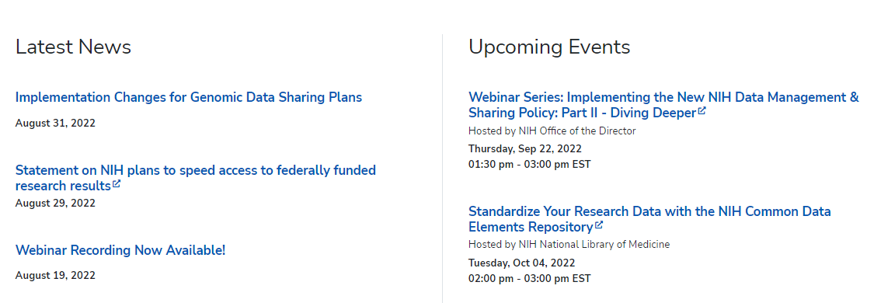
Stay in the loop!
BLOGS
LISTSERVS
Extramural Nexus
NIH Guide to Grants & Contracts
Office of Science Policy News
NIH Scientific Data Sharing News & Events
Under the Poliscope
Open Mike
SOCIAL MEDIA
@NIHGrants
@NIH_OSP
News & Events

